Slide 1
STRING

Slide 2
String:
It is a group of characters enclosed within double quotes called string.
Declaration:
char c[] = "c string";
Program: (read string)
#include<stdio.h>
int main(){
char name[20];
printf("Enter Name : ");
scanf("%s",&name);
printf("Entered Name is %s\n",name);
return 0;
}
Output:
Enter Name : Abi
Entered Name is Abi

Slide 3
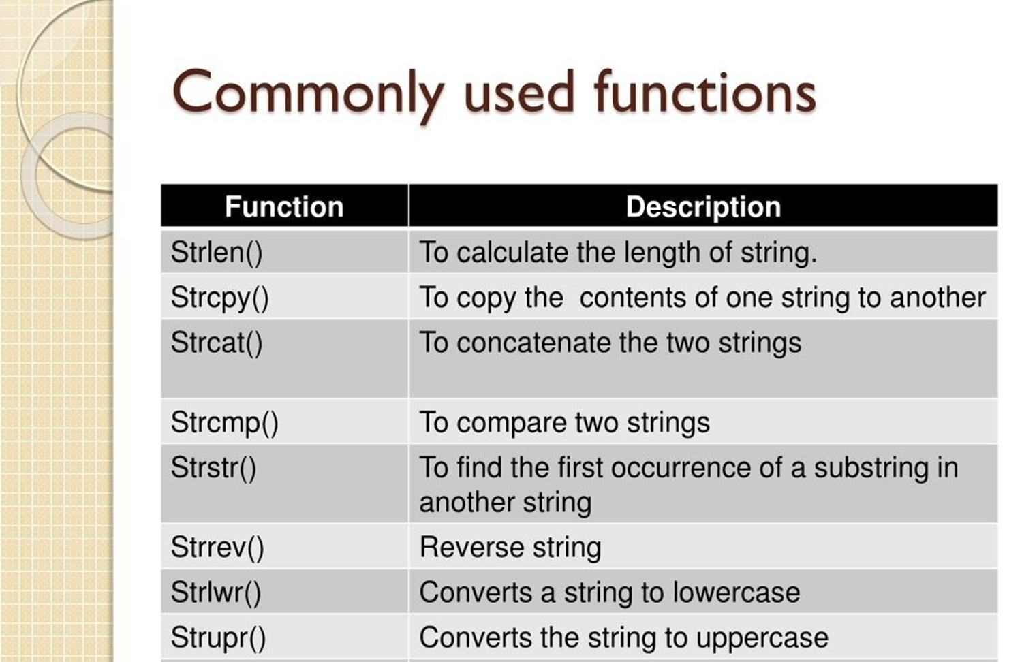
String function:

Slide 4
strlen():
Program:(string length)
#include<stdio.h>
#include<string.h>
int main(){
char name[20]="networkz system";
printf("Length of the string is : %d",strlen(name));
return 0;
}
Output:
Length of the string is : 15

Slide 5
Strcat():
It is used to concatenate(join) two strings.
Program:
#include<stdio.h>
#include<string.h>
int main(){
char name[20]="Hello";
char name1[20]=" World";
//printf("%s\n",strcat(name,name1));
strcat(name,name1);
puts(name);
return 0;
}
Output:
Hello World

Slide 6
strcpy():
Program: ( string copy )
#include<stdio.h>
#include<string.h>
int main(){
char name[20]="networkz system";
char name1[20];
strcpy(name1,name);
printf("Copied string is '%s’ ",name1);
//printf("Copied string is '%s’ ",strcpy(name1,name),name1);
return 0;
}
Output:
Copied string is 'networkz system'

Slide 7
strcmp() :Compare two string
Program:(compare)
#include<stdio.h>
#include<string.h>
int main(){
char name[20]="networkz system";
char name1[20]="networkz system";
int c=strcmp(name,name1);
//printf("Result is %d",c);
if(c==0){
printf("Values are equal");
} else{
printf("Values are not equal ");
}
return 0; }
Output:
Values are equal

Slide 8
strrev():
Program:
#include<stdio.h>
#include<string.h>
int main(){
char name[20]="networkz";
printf("%s\n",strrev(name));
puts(name);
return 0;
}
Output:
zkrowten
zkrowten

Slide 9
strlwr() :
Program:
#include<stdio.h>
#include<string.h>
int main(){
char name[20]="NETWORKZ";
printf("%s\n",strlwr(name));
strlwr(name)
puts(name);
return 0;
}
Output:
networkz

Slide 10
strupr() :
Program:
#include<stdio.h>
#include<string.h>
int main(){
char name[20]="networkz";
//printf("%s\n",strupr(name));
strupr(name);
puts(name);
return 0;
}
Output:
NETWORKZ

Slide 11
strstr():
Program:
#include<stdio.h>
#include<string.h>
int main(){
char a[20]="hi world wecome";
char b[10]="world";
printf("%s\n",strstr(a,b));
return 0;
}
Output:
world wecome
Program:
#include<stdio.h>
#include<string.h>
int main(){
char a[20]="hi world wecome";
char b[10]="world";
char* result;
result=strstr(a,b);
printf("%s",result);
return 0;
}

